Slide 1




Autonomous Lunar Vehicle
Team 45
Notes:
Katie

Slide 2
Project Introduction
Harris requested the team design an Autonomous Lunar Vehicle (ALV)
Autonomous navigation to specific locations
Accurately place radio antenna units at locations
Easily re-programmable to store mission information
Detect unknown hazards
Execute mission in under 10 minutes
Notes:
Katie

Slide 3
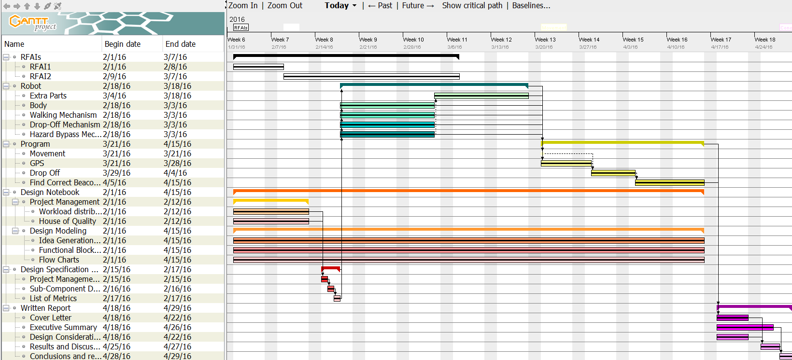
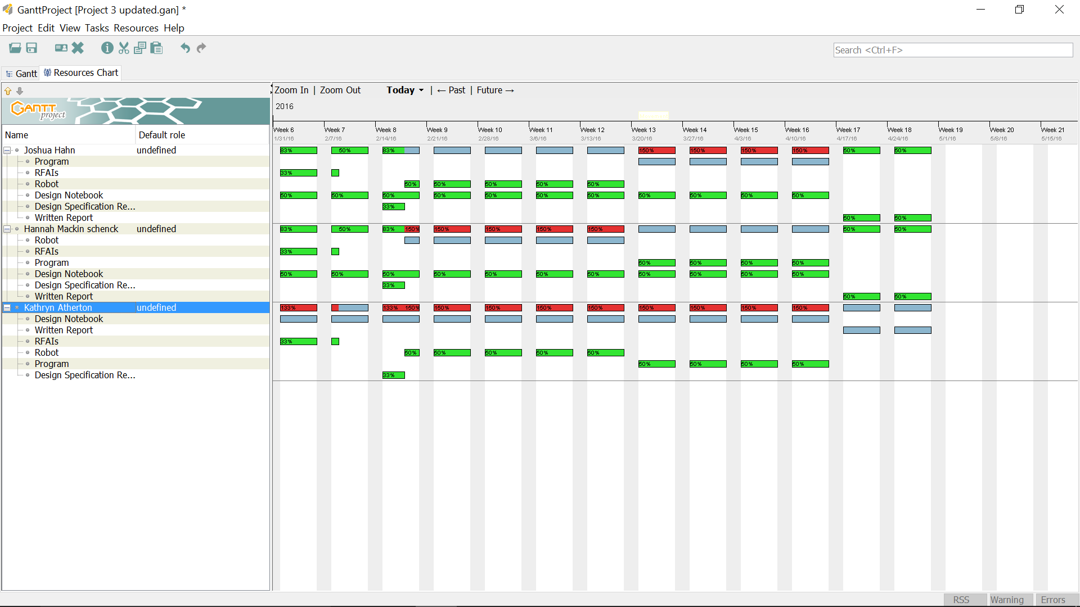
Team Strategies
The team focused on a different aspect during different months of the project
February: Robot design and building
March: Solidifying logic and code
April: Obtaining and reporting data
Additionally, each member focused on a portion of the project to optimize each individual’s skills
Robot Build: Hannah
Coding Logic: Joshua
Notebook: Kathryn
Members took the lead on their assigned task, but all members contributed to and made decisions on all deliverables
Notes:
Katie

Slide 4
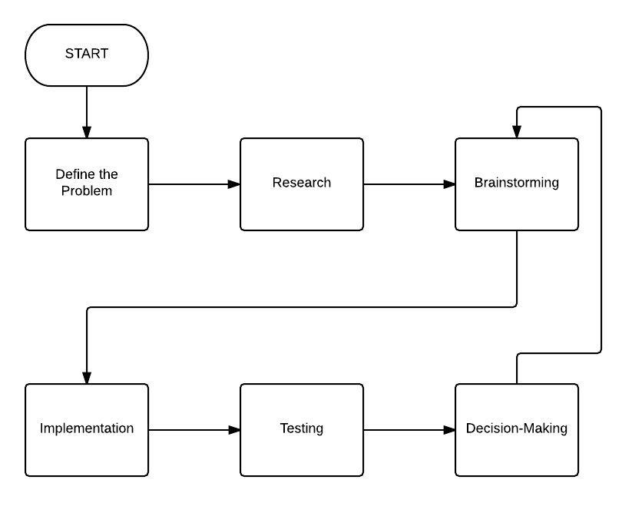
Mechanical Design Process
Defined problem based on description, created design specification based on requirements to determine success of design
Researched designs for wheeled robots, GPS code logic
Brainstormed ideas in the form of a morphological chart for designing subcomponents
Created prototypes based on ideas from morphological chart
Tested prototypes against design specifications
Decided upon the most successful prototype based on performance and overall rating in a House of Quality
Notes:
Katie

Slide 5
Basic Design Specifications and Goals of Project
Technical Need | Target Value
Velocity | 2 feet / second
Stopping Distance from Given Specific Location | < 3 cm
Difference in Location from where Robot is to where it thinks it is | < 5 cm
Difference in Direction from where Robot is facing to where it thinks it is facing | < 10 degrees
Height of Hazards Able to Overcome | > 20 mm
Weight able to Carry | > 600 grams
Distance from edge of antenna to edge of beacon | 0 cm
Number of antenna placed with the correct side facing up | 3/3
Value of errors ALV can handle | >= 32 (i.e. 2, 4, 8, 16, 32)
Notes:
Hannah

Slide 6
Morphological Chart
System | Means
Body | Tank | Multi-wheel design
Wheels | treads | big wheels | small wheels
Drop-off system | bed with treads | separate container for each antenna
Drop-off location w/ respect to robot | behind | to the side(s)
Overcome obstacles | snow plow | drive over
Notes:
Hannah

Slide 7
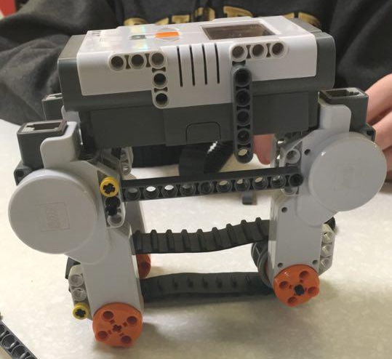
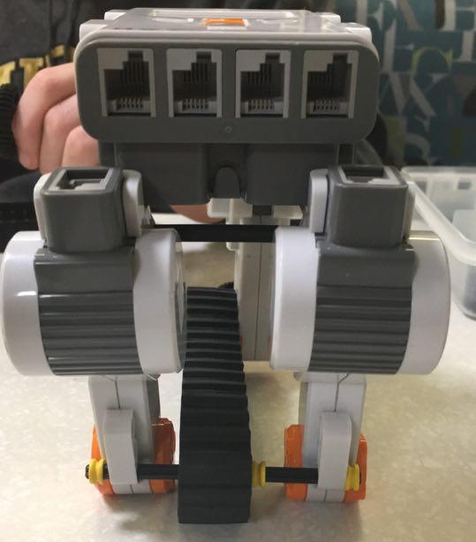
Prototype 1 Description
Multi-wheel design
Small wheels
Conveyor belt-style drop-off system
Antenna dropped behind ALV
Antenna protected within body of robot
Rejected due to lack of space above conveyor belt
Notes:
Hannah

Slide 8
Prototype 2 Description
Basic framework for NXT robot
Multi-wheeled design
Small wheels
Conveyor belt-style drop-off
Cage over conveyor belt
3D printed slide behind conveyor belt
Final design decided upon by team
Notes:
Hannah

Slide 9
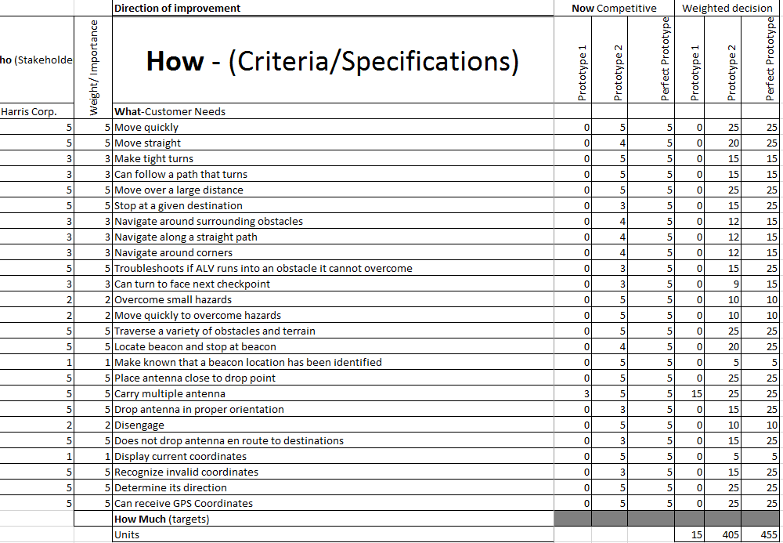
House of Quality
Prototype 1 -- Total Score 15/ 455 = 3.30%
Prototype 2 -- Total Score 405/455 = 89.01%
Notes:
Hannah

Slide 10

Software Design Process
Robot Movement and Turning
Time
Encoder Counts
Gyro Sensor
Determining Robot’s Location on Lunar Surface
GPS coordinates
Environmental cues and ultrasonic sensor
Assume robot stays on path
Path Navigation
Wavefront Search Algorithm
Hard code path to follow
Sample Wavefront Map
Notes:
Josh

Slide 11
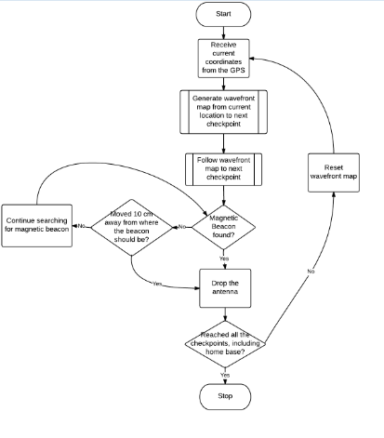
Flowchart of Robot Logic
Notes:
Josh

Slide 12
Expectations vs. Performance in Final Demonstration
Expectations
Path Navigation
Can navigate to each checkpoint
Can overcome rough terrain up to 20 mm
Bluetooth Communication
Receive correct coordinates 100% of time using manual application
Antenna Dropping Accuracy
66% in correct orientation, 100% in correct place
Performance
Path Navigation
Made it to checkpoint A
Not an issue with terrain but with bluetooth
Bluetooth Communication
Did not receive correct coordinates due to an error in the height being sent
Antenna Dropping Accuracy
66% in correct orientation, 100% in correct place
Notes:
Josh

Slide 13
Pros and Cons of Design
Pros
Compact design for storage in shuttle and maneuverability
Accurate turning system
Easily traverses rough terrain of course
Can accurately determine location using Bluetooth
Adaptable to real life mission
Consistent navigation
Cons
Reliant on GPS coordinates
Bluetooth communication slows down the robot
Wavefront search uses lots of memory and is not super efficient
Antenna units are dropped with 66% accuracy and depend on weight of antenna
Encounters issues if turned away from a cardinal direction
Notes:
Josh

Slide 14
Areas of Improvement
Determine causes of abnormal behavior in robot performance
Improve accuracy of antenna dropping system by changing length of slide
Improve navigation to be able to move in any direction for any distance
Speed up program execution
Notes:
Josh

Slide 15
Questions?
Thanks for listening!
--Team 45
Notes:
Katie

